Slide 1
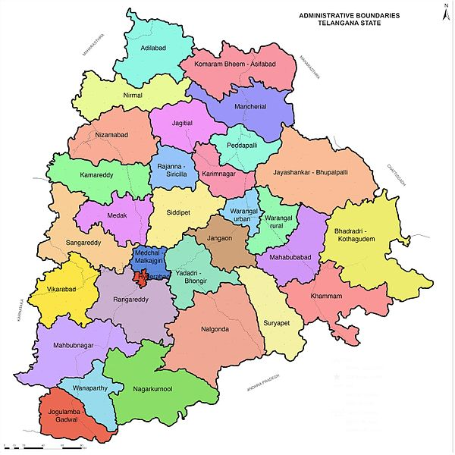
Insights for Telangana govt Tourism Department using Python Domain: Tourism
Niharika Miriyala
This Photo by Unknown Author is licensed under CC BY-SA

Slide 2
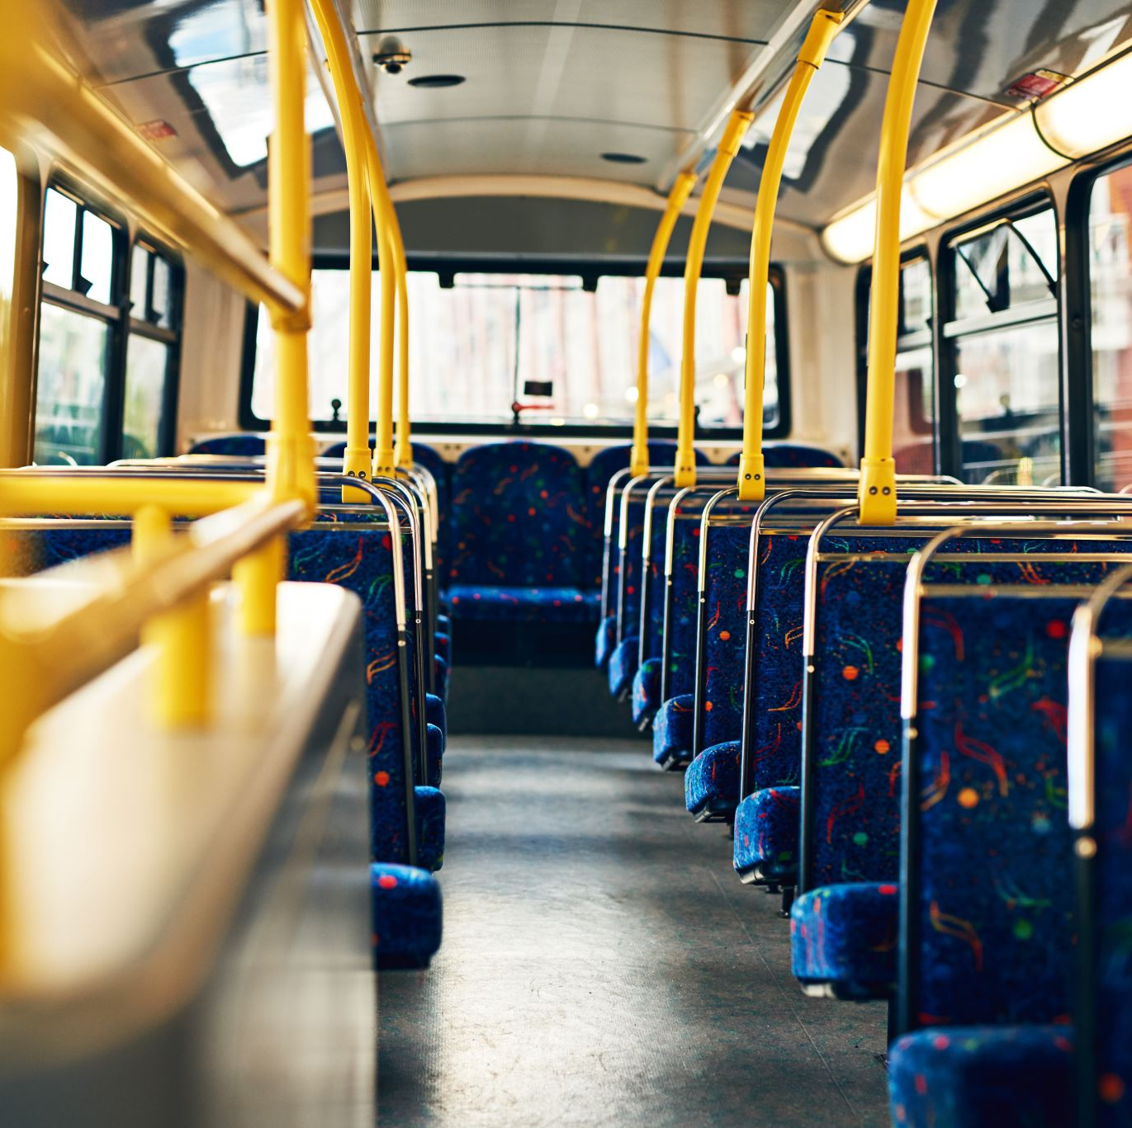
AGENDA:
Telangana tourism has been actively promoting tourist attractions and experiences to attract tourists from across the globe.
Data analysis is of utmost importance for the Telangana Government Tourism Department as it empowers them to make data-driven decisions, understand tourist behavior, optimize resource allocation, evaluate performance, manage risks, plan for the future.
By leveraging the power of data, the department can enhance tourism experiences, drive economic growth, and promote Telangana as a preferred tourist destination.

Slide 3

Data Collection and Preparation
The dataset is taken from Open Data Telangana https://data.telangana.gov.in/

Slide 4
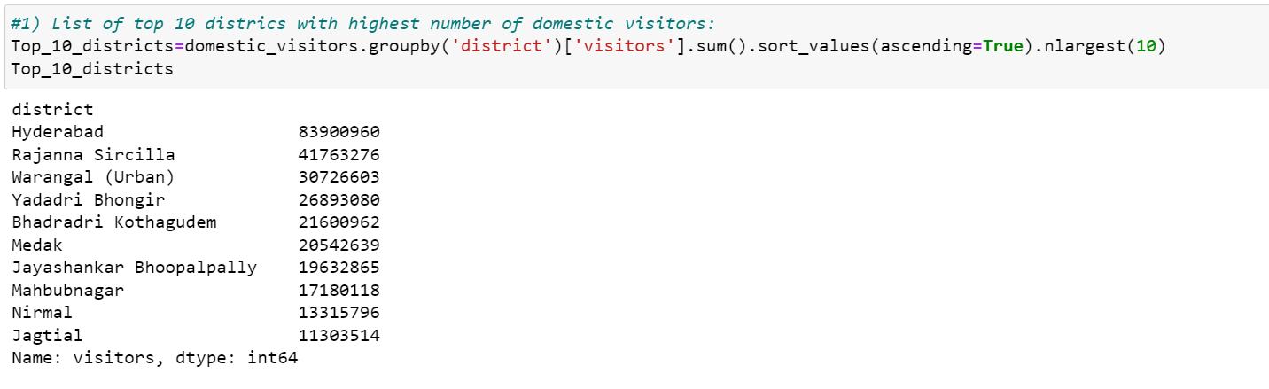
Key Insights
List of top 10 districts with highest number of domestic visitors:

Slide 5
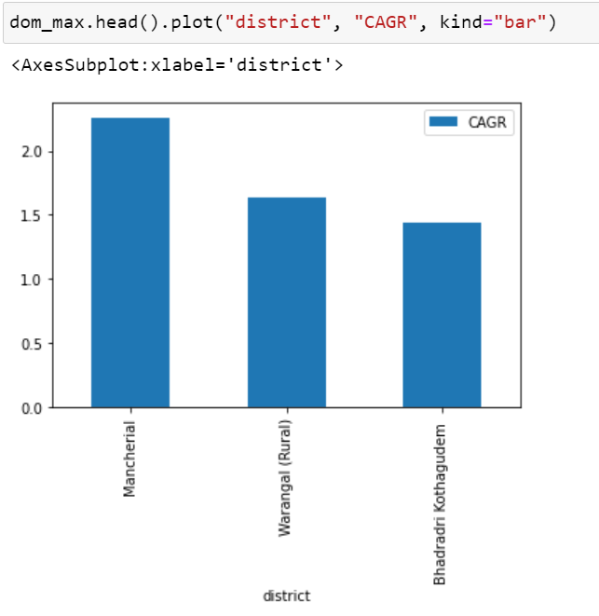
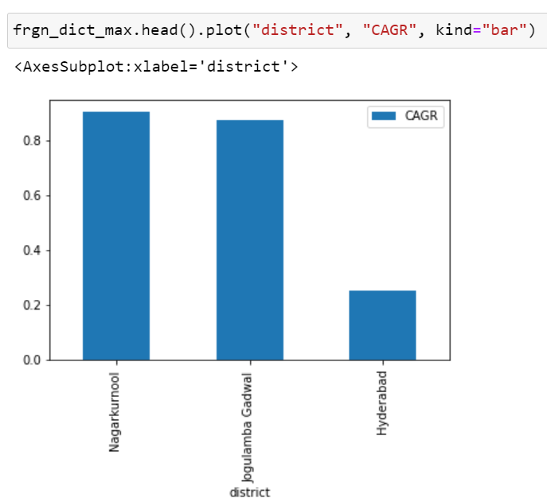
Key Insights
Domestic Visitors
Foreign Visitors
Districts that are growing well:

Slide 6
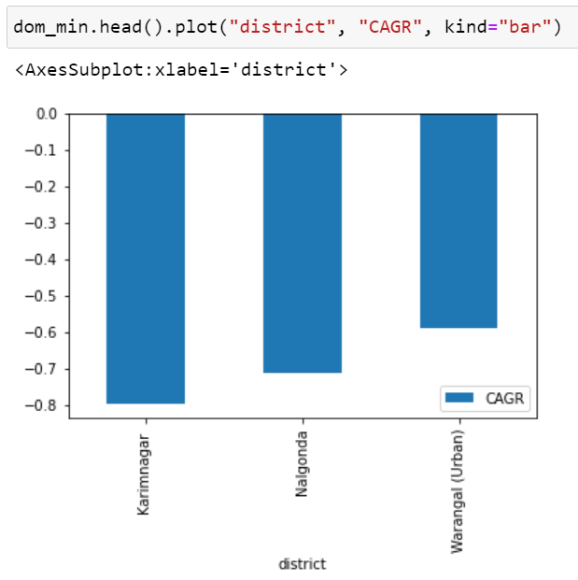
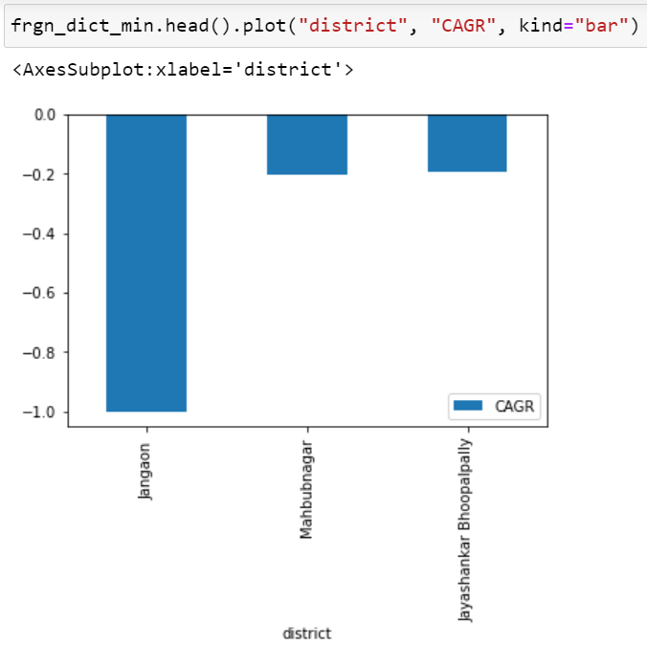
Key Insights
Domestic Visitors
Foreign Visitors
Districts that are declining:

Slide 7
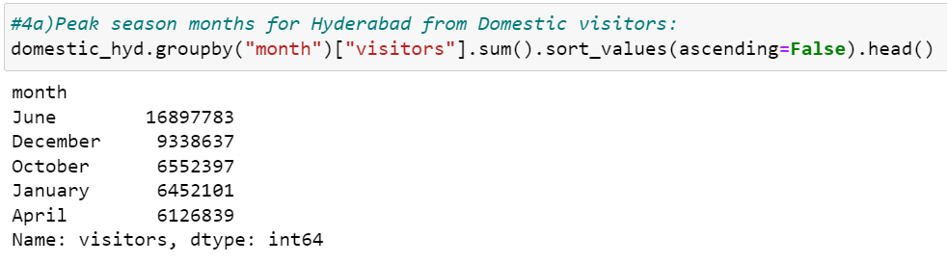
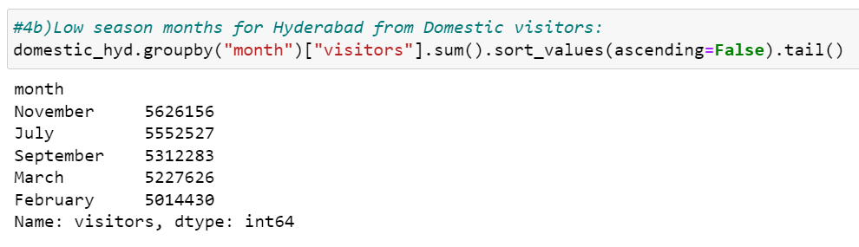
Key Insights
Peak months
Low Peak months Visitors

Slide 8
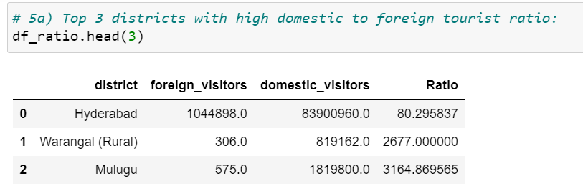
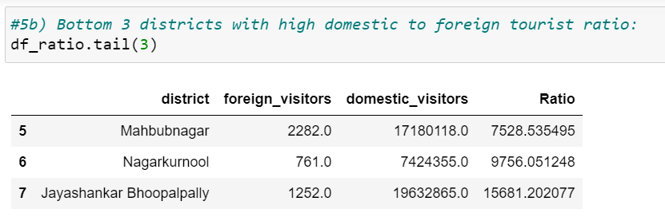
Key Insights
Domestic to Foreign tourist ratio:
Top Districts:
Bottom Districts:

Slide 9

RECOMMENDATIONS:
Tourist destinations with high potential need to have
Improved infrastructure development
Marketing promotions & Visitor services
Collaboration with stakeholders
Establish a regulatory framework
During peak season, government need to introduce new events to attract more tourist base.
Government can learn from the top performing districts and can replicate the same in the low performing districts to attract more foreign visitors as foreign visitors bring more revenue

